Slide 1
Unit III Engineering Materials
Topic: Polymer composite - fiber reinforced plastics
Dr. P. G. Umape
Department of Applied Science
Pune Institute of Computer Technology

Slide 2
Learning outcomes
Students will be able to
Define composite material
classify composite material
Discuss composition and properties of Fiber reinforced plastics.
Discuss application of Fiber reinforced plastics.

Slide 3
Polymer Composites
Polymer is a versatile material and due to its appreciable physical properties, molding ability it has ability to substitute classical engineering materials.
But its mechanical properties and dimensional strength has to be increased for its efficient use as an engineering material.
It can be achieved by addition of some external materials with the polymer.

Slide 4
Polymer Composites
Here polymer used is called as matrix phase or substrate.
While the external material added in polymer is called as reinforced material or dispersed phase.
A polymer composite is a mixture of polymer matrix with reinforced material with distinct phases resulting a symbiotic properties that are higher than either component alone.

Slide 5
Polymer Composites
Polymer composite:
Objective of adding polymer:
To bind the reinforcing particles or fibres strongly.
Acts as a medium for distribution of applied load.
Keeps proper orientation of reinforcing fibres for high strength development.
To prevent cracks propagation due to plasticity.

Slide 6
Polymer Composites
Condition:
The Matrix phase and reinforced phase must have good compatibility with each other.
There should be strong bond formation between 2 phases after composite formation.

Slide 7
Polymer Composites
Types of Composite material: Based on matrix
1. Metal matrix composite
Metals like aluminum, magnesium, copper used as matrix while ceramic or metallic materials are used as reinforcing agent.
2. Ceramic matrix composite
Ceramic matrix dispersed by metal or ceramic reinforcing agent.
3. Polymer matrix composite
Here matrix used is polymer, may be thermosetting or thermosoftening polymer.

Slide 8
Polymer Composites
Types of Composite material:
Based on reinforcing agent
Particles Reinforced composite
here the reinforced material is particles of metal or ceramic materials in the form of flakes.
Structural Composites
Here composite material is formed by several layers of reinforced materials.

Slide 9
Polymer Composites
Based on reinforcing agent
Structural Composites
Laminar – Sheets or panels with proper orientation & cemented together with resin. E. g. Plywood
Sandwiched – 2 strong outer sheets separated by a layer of less dense material (core)
Fiber Reinforced composite
Fibers of glass, polymer fibers, carbon fibers are used as reinforcing agent.

Slide 10
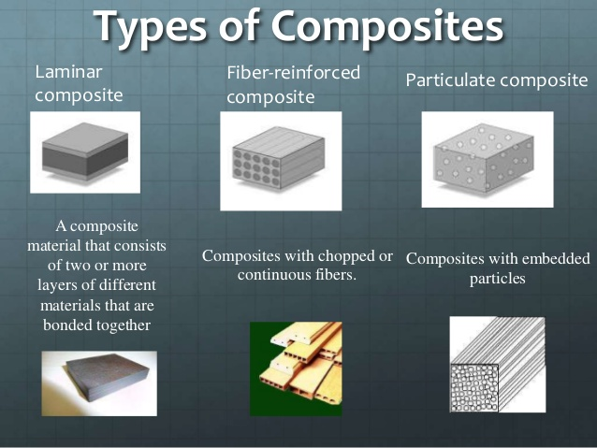

Slide 11
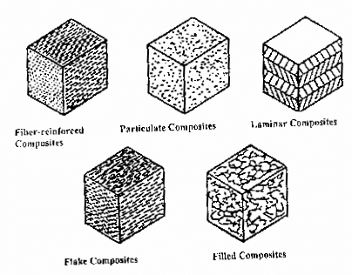

Slide 12
Fiber reinforced plastics
Fiber reinforced composites (FRP) are composites prepared by the incorporation of fibers(dispersed phase) into plastic material.
Fibers used are glass, carbon & aramid fibers as reinforcing agents.
Fiber arrangement may be continuous and aligned or discontinuous or fibers may be chopped and enforced in plastic matrix.

Slide 13
Fiber reinforced plastics
Fiber reinforced composites (FRP) : Here the mechanical properties of composite depends on
Interfacial bond between fiber and matrix, fiber-orientation, concentration, length and properties of fiber and matrix.

Slide 14
Fiber reinforced plastics
Properties of FRP:
Low coefficient of expansion
Low cost of production
High tensile strength
High heat stability
High dimension stability
Better abrasion resistance
Better toughness and impact strength

Slide 15
Fiber reinforced plastics
Applications of FRP:
Automobile bodies, chasis parts, vehicle components
Boats body, propeller shafts
Parts of aircrafts
Sport goods, musical instruments, toys etc
High speed machinary parts, PCB, bodies of refrigerators, coolers, cabins for offices, windows, doors.

Slide 16


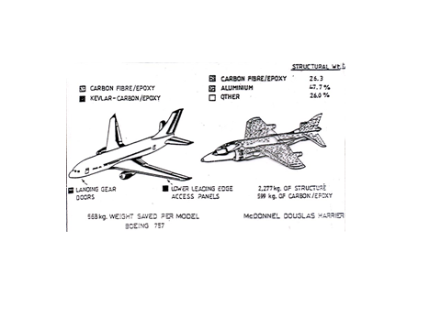
Applications of FRPs

Slide 17
summary
Definition of composite materials
Types of composite materials
Composition of Fiber reinforced plastics
Properties of Fiber reinforced plastics
Applications of Fiber reinforced plastics

